Slide 1

R Programming
PHANI RAJ B.N.

Slide 2
Your best quote that reflects your approach… “It’s one small step for man, one giant leap for mankind.”
- Neil Armstrong

Slide 3
What is R Programming language?
A programming language and software environment designed primarily for statistical computing, data analysis, and graphical representation.
Developed in the early 1990s by Ross Ihaka and Robert Gentleman at the University of Auckland, New Zealand, as a free and open-source implementation of the S language, with additional features.
R is widely used among statisticians, data analysts, and data scientists and has a vast library of tools for data manipulation, statistical analysis, and visualization.

Slide 4
Features
Data Handling and Manipulation
Statistical Analysis and Modeling
Data Visualization
Packages and Community Support
Integration with Other Languages
Reproducible Research and Reporting
Applications in Data Science and Industry
Notes:
### 1. ****
- **Data Frames and Vectors:** R provides flexible structures for handling data, such as data frames (similar to spreadsheets), vectors, matrices, and lists.
- **Data Manipulation Libraries:** Packages like `dplyr`, `tidyr`, and `data.table` make data cleaning, transformation, and wrangling efficient.
### 2. **Statistical Analysis and Modeling**
- R has a rich set of built-in functions and packages for statistical analysis, covering everything from basic descriptive statistics to complex statistical models.
- Packages like `lm()` for linear models and `glm()` for generalized linear models offer easy model fitting.
- Libraries like `caret`, `MASS`, and `randomForest` support machine learning and advanced statistical modeling.
### 3. **Data Visualization**
- R's graphics capabilities are powerful, offering both base plotting and advanced visualization libraries.
- **ggplot2:** A popular package that follows the "Grammar of Graphics" and provides extensive control for customizing plots.
- R also supports libraries like `plotly` for interactive and web-based visualizations.
### 4. **Packages and Community Support**
- CRAN (Comprehensive R Archive Network) hosts thousands of packages that extend R’s capabilities for specialized tasks, such as bioinformatics, finance, geospatial analysis, and text mining.
- R’s open-source nature means it has a large community and extensive support, including online forums, documentation, and books.
### 5. **Integration with Other Languages**
- R can interface with other programming languages, including Python, C++, and Java. Packages like `reticulate` enable the integration of Python code within R, leveraging libraries from both ecosystems.
### 6. **Reproducible Research and Reporting**
- **R Markdown:** An authoring format that allows users to combine code, output, and documentation into a single document, making it ideal for reproducible research and reports.
- **Shiny:** A web application framework that lets users create interactive web applications directly from R.
### 7. **Applications in Data Science and Industry**
- R is popular in academia and industry for data analysis, statistical computing, and research. Many industries, such as finance, healthcare, and government, use R for analysis, predictive modeling, and decision-making.

Slide 5
Software Components
R Language Environment
R Base: Download and install the R environment from the CRAN website. This includes the R interpreter, standard libraries, and the console for running R commands.
Download R-4.4.1 for Windows. The R-project for statistical computing.
Supported on Windows, macOS, and Linux.
Add the Path Variable to hold the location of R’s Bin directory that contains the RScript Location.
Integrated Development Environment (IDE):
Rstudio
VS Code
Jupyter Notebooks.
Notes:
Rstudio: The most popular IDE for R, offering features like syntax highlighting, debugging, package management, and a viewer for plots and data. RStudio has both open-source (free) and premium versions and can be downloaded from RStudio's website.
RStudio: The most popular IDE for R, offering features like syntax highlighting, debugging, package management, and a viewer for plots and data. RStudio has both open-source (free) and premium versions and can be downloaded from RStudio's website.
VS Code with R Extension: Visual Studio Code can be set up for R development with the R extension, which adds R syntax support, an R console, and plotting capabilities.
Jupyter Notebooks: Supports R through the IRKernel package, useful for interactive development, particularly in data science and machine learning.

Slide 6
Additional Components
CRAN Packages
Database Drivers: RMySQL, RPostGreSQL.
Web Application Frameworks: Shiny and Plumber.
Documentation and Reporting
Pandoc: Required for R Markdown to HTML, PDF, and Word conversions, and is bundled with RStudio.
LaTeX: Necessary if you want to generate PDF reports from R Markdown (e.g., MikTeX or TinyTeX).

Slide 7
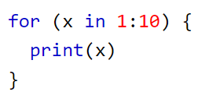
Syntax
To output text in R, use single or double quotes.
To output numbers, just type the number
To do simple calculations, add numbers together
Notes:
"Hello World!“
R does have a print() function available if you want to use it. This might be useful if you are familiar with other programming languages, such as Python, which often uses the print() function to output code.
It is up to you whether you want to use the print() function to output code. However, when your code is inside an R expression (e.g. inside curly braces {} like in the example above), use the print() function to output the result.

Slide 8
Comments
R uses # to create comments,very similar to Python.
There are no multi line comments in R.
Notes:
Commen

Slide 9
Variables
Variables are containers for storing data values.
To assign values to variables use <- sign.
To Print U can simply use the variable.
R does have a print() function available if you want to use it.
Notes:
name <- "John" age <- 40 name # output "John" age # output 40
In other programming language, it is common to use = as an assignment operator. In R, we can use both = and <- as assignment operators.
However, <- is preferred in most cases because the = operator can be forbidden in some contexts in R.
for (x in 1:10) { print(x) }

Slide 10
Concatenate Elements
Use the Paste function
Notes:
text <- "awesome" paste("R is", text)
text1 <- "R is" text2 <- "awesome" paste(text1, text2)

Slide 11
Naming Conventions
A variable can have a short name (like x and y) or a more descriptive name (age, carname, total_volume). Rules for R variables are:
A variable name must start with a letter and can be a combination of letters, digits, period(.)
and underscore(_). If it starts with period(.), it cannot be followed by a digit.
A variable name cannot start with a number or underscore (_)
Variable names are case-sensitive (age, Age and AGE are three different variables)
Reserved words cannot be used as variables (TRUE, FALSE, NULL, if...)
Notes:
# Legal variable names: myvar <- "John" my_var <- "John" myVar <- "John" MYVAR <- "John" myvar2 <- "John" .myvar <- "John"

Slide 12
Data Types
Variables do not need to be declared with any particular type, and can even change type after they have been set
numeric - (10.5, 55, 787)
integer - (1L, 55L, 100L, where the letter "L" declares this as an integer)
complex - (9 + 3i, where "i" is the imaginary part)
character (a.k.a. string) - ("k", "R is exciting", "FALSE", "11.5")
logical (a.k.a. boolean) - (TRUE or FALSE)
Use the class() function to check the data type of a variable
Notes:
# numeric x <- 10.5 class(x) # integer x <- 1000L class(x) # complex x <- 9i + 3 class(x) # character/string x <- "R is exciting" class(x) # logical/boolean x <- TRUE class(x)

Slide 13
Numbers
There are three number types in R:
numeric : A numeric data type is the most common type in R, and contains any number with or without a decimal
integer : Integers are numeric data without decimals
complex : A complex number is written with an "i" as the imaginary part
You can convert from one type to another with the following functions:
as.numeric()
as.integer()
as.complex()
Notes:
x <- 1L # integer
y <- 2 # numeric
# convert from integer to numeric:
a <- as.numeric(x)
# convert from numeric to integer:
b <- as.integer(y)
# print values of x and y
x
y
# print the class name of a and b
class(a)
class(b)

Slide 14
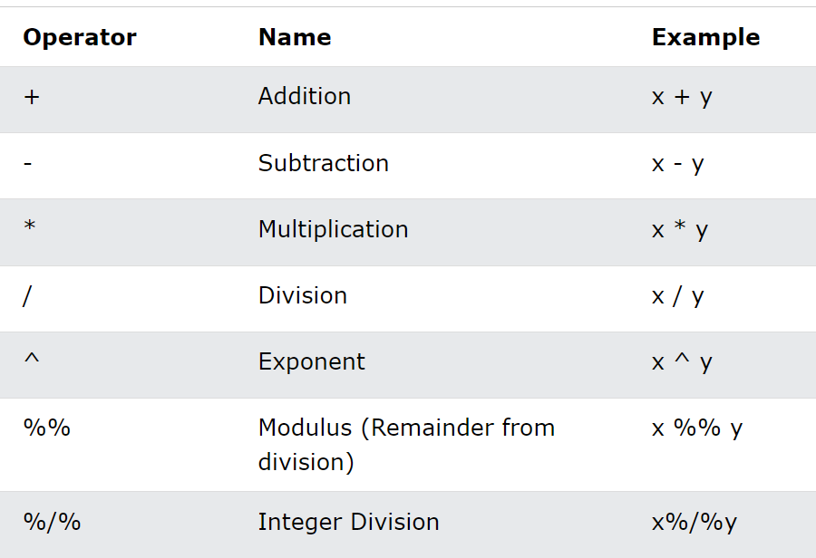
Math Functions
Use operators to perform common mathematical operations on numbers.

Slide 15
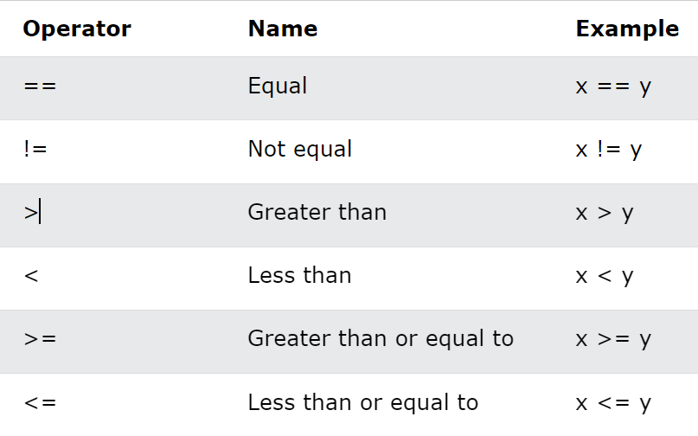
Comparison Operators

Slide 16
Strings in R
A string is surrounded by either single quotation marks, or double quotation marks
String to a variable is done with the variable followed by the <- operator
To find the number of characters in a string, use the nchar() function
cat function: If U want the line breaks to be inserted at the same position as in the code
grepl() function to check if a character or a sequence of characters are present in a string
paste() function to merge/concatenate two strings
An escape character is a backslash \ followed by the character you want to insert

Slide 17
Statements and Expressions
If…else
While Loop: Execute a set of statements as long as a condition is TRUE
For Loop: used for iterating over a sequence
To exit the loop, we use a break statement.
To skip and continue with the next iteration, we use the next statement.
Notes:
i <- 1 while (i < 6) { print(i) i <- i + 1 }
i <- 1 while (i < 6) { print(i) i <- i + 1 if (i == 4) { break } }
fruits <- list("apple", "banana", "cherry") for (x in fruits) { print(x) }
i <- 0 while (i < 6) { i <- i + 1 if (i == 3) { next } print(i) }
For in R is less like the for keyword in other programming languages and works more like an iterator method as found in other object-oriented programming languages
for (x in 1:10) { print(x) }

Slide 18
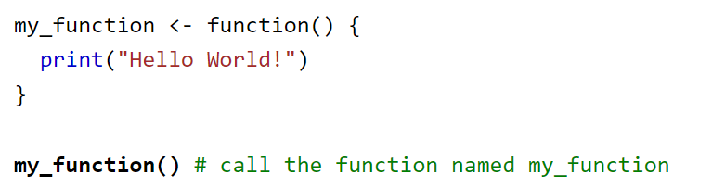
Functions in R
A function is a block of code which only runs when it is called.
You can pass data, known as parameters, into a function.
A function can return data as a result

Slide 19
Data Structures of R
Vectors
Lists
Arrays
Matrices
DataFrames
Factors
Notes:
Data

Slide 20
Vectors in R.
A list of items that are of the same type.
Use the c () function to create a vector and add items to it separated by,
U can create a vector of series using: operator.
Length method is used to get the no of elements.
U can sort the elements either alphabetically or numerically.
Use the index to access individual elements of the vector.
Notes:
# Vector of strings fruits <- c("banana", "apple", "orange") # Print fruits fruits
# Vector with numerical values in a sequence numbers <- 1:10 numbers
fruits <- c("banana", "apple", "orange", "mango", "lemon") numbers <- c(13, 3, 5, 7, 20, 2) sort(fruits) # Sort a string sort(numbers) # Sort numbers

Slide 21
Functions with Arguments
Information can be passed into functions as arguments.
Arguments are specified after the function name, inside the parentheses. You can add as many arguments as you want, just separate them with a comma.
A parameter is the variable listed inside the parentheses in the function definition.
An argument is the value that is sent to the function when it is called.
A function must be called with the correct number of arguments
U can create default arguments by assigning a value to it in the function.
return keyword is used to return a value.

Slide 22
Global Variables
Variables that are created outside of a function are known as global variables.
Global variables can be used by everyone, both inside of functions and outside.
U can create global variables within a function too.
To change the value of a global variable inside a function, refer to the variable by using the global assignment operator <<-
Notes:
# Create a variable outside of a function and use it inside the function:
txt <- "awesome"
my_function <- function() {
paste("R is", txt)
}
my_function()
#Create a variable inside of a function with the same name as the global variable:
txt <- "global variable"
my_function <- function() {
txt = "fantastic"
paste("R is", txt)
}
my_function()
txt # print txt
#If you use the assignment operator <<-, the variable belongs to the global scope:
my_function <- function() {
txt <<- "fantastic"
paste("R is", txt)
}
my_function()
print(txt)
#To change the value of a global variable inside a function, refer to the variable by using the global assignment operator <<-:
txt <- "awesome"
my_function <- function() {
txt <<- "fantastic"
paste("R is", txt)
}
my_function()
paste("R is", txt)

